Slide 1
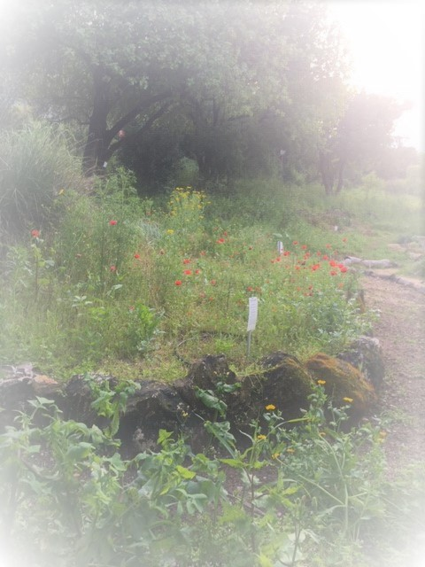
Workshop: Smart and Effective Instruction in English Vocabulary Bands, Reading and Spelling Dr. Fern Levitt David Yellin College Dr. Janina Kahn-Horwitz Oranim College

Slide 2
Evidence that English reading acquisition is complex. Years of reading instruction required to achieve familiar word recognition (Seymour, Aro & Erskine, 2004):
2.5 years | English
2 years | Danish
1 year | Most other European orthographies

Slide 3
Simple View of Reading (Gough & Tunmer, 1986)

Slide 4
What’s in a word? Bowers & Bowers, 2017; Perfetti & Hart, 2002
action
jumped
night

Slide 5
Lexical quality assists in anchoring a word in memory (Perfetti & Hart, 2002).

Slide 6
Finding ourselves in the field unequipped to help children learn to read and write English (Fuchs, 2017; Goldfus, 2012; Kahn-Horwitz, 2015; 2016; Roffman, 2012)
English L1 teachers with knowledge about the English writing system were more successful in teaching children to read and spell (Piasta, McDonald Connor, Fishman & Morrison, 2009).
The Peter Effect – you cannot teach what you do not know (Binks-Cantrell, Washburn, Joshi, & Hougan, 2012; Saban & Kahn-Horwitz, 2021; Vaisman & Kahn-Horwitz, 2020).
Notes:
What does an English teacher need to teach reading and spelling?

Slide 7
Lesson Plan Process
letter
word
sentence
text

Slide 8
Brainstorm words with /ou/.
ou
………………
………………
………………
………………

Slide 9
Creating a mini-lesson with ‘ou’ Examples of words/collocations
Band 1 | Band 2 | Band 3: 1 | Band 3: 2
house | amount | account | be unclear about
mouth | proud | bank account | burn out
about | discount | check out | bring sth out
count | found | go out | count on sth
loud | mouse | run out of | no doubt
about | move out | speak about | out of control
sound | pronounce | throw out sth | outcome
shout | thinking about | take sb out | stay out
out | doubt | just about | outside

Slide 10
Write “ou” in your notebooks.
Write a keyword with “ou” and at the back of the page translate or draw a picture of the key word.
Write “ou” a few times while pronouncing the phoneme.

Slide 11
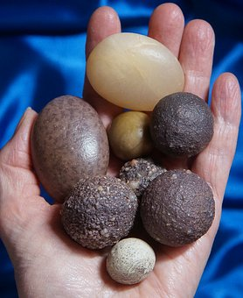
Read these words aloud. Label the pictures.
house
mouth
out
found
loud

Slide 12
Choose 5 words you would like to learn with <ou>
I can count to 10 in English.
count
1. mouse**
2. house*
3. discount**
4. shout*
5. out*
6. amount**
7. about**
8. count*
לספור
9. move out**
10. mouth*
11. loud*
12. found**
13. pronounce**
14. speak about***
Notes:
* A1. ** A2. ***B1

Slide 13
Read these sentences.
I am thinking about getting out of my house.
We were sitting outside. There were loud sounds around us.
I have run out of milk. The milk I have is out-of-date.
I was just about to log out when I found an outstanding message on my screen.

Slide 14
Summary
Review “ou”.
What is your key word?
Spell and pronounce it.
Homework: Write sentences with “ou” words.
http://etymonline.com/

Slide 15
Orthographic mini-lessons combining graphemes and frequent vocabulary
Design a mini-lesson. Choose a grapheme or orthographic convention. You may use my example or your ideas.
We will share our mini-lessons at the end of the workshop.

Slide 16
Link to Band Words Link to spreadsheet Handouts

Slide 17
Link to this PowerPoint How to Create Mini-Lessons

Slide 18
janina_k@oranim.ac.il
flevitt@mindspring.com

